Slide 1
Shop Conveniently & Boost Sales
Robin Bista
Data Science Project
03/20/2021

Slide 2
Introduction
Walmart experience
How do retailers configure the aisle for products?
Can they trick us to optimize their sales?
We will use Apriori algorithm to find the set of rules that will helps us arrange items accordingly

Slide 3
Objective
Apriori algorithm uses the association rules to find the set of rules which expresses the probabilistic. It creates association rules to find the relation between items in frequent itemset.
We will use these rules to plot graphs like histogram, interactive scattered plot and Graph-based visualization to evaluate subsets of items which must be grouped together and placed in the adjacent aisle

Slide 4
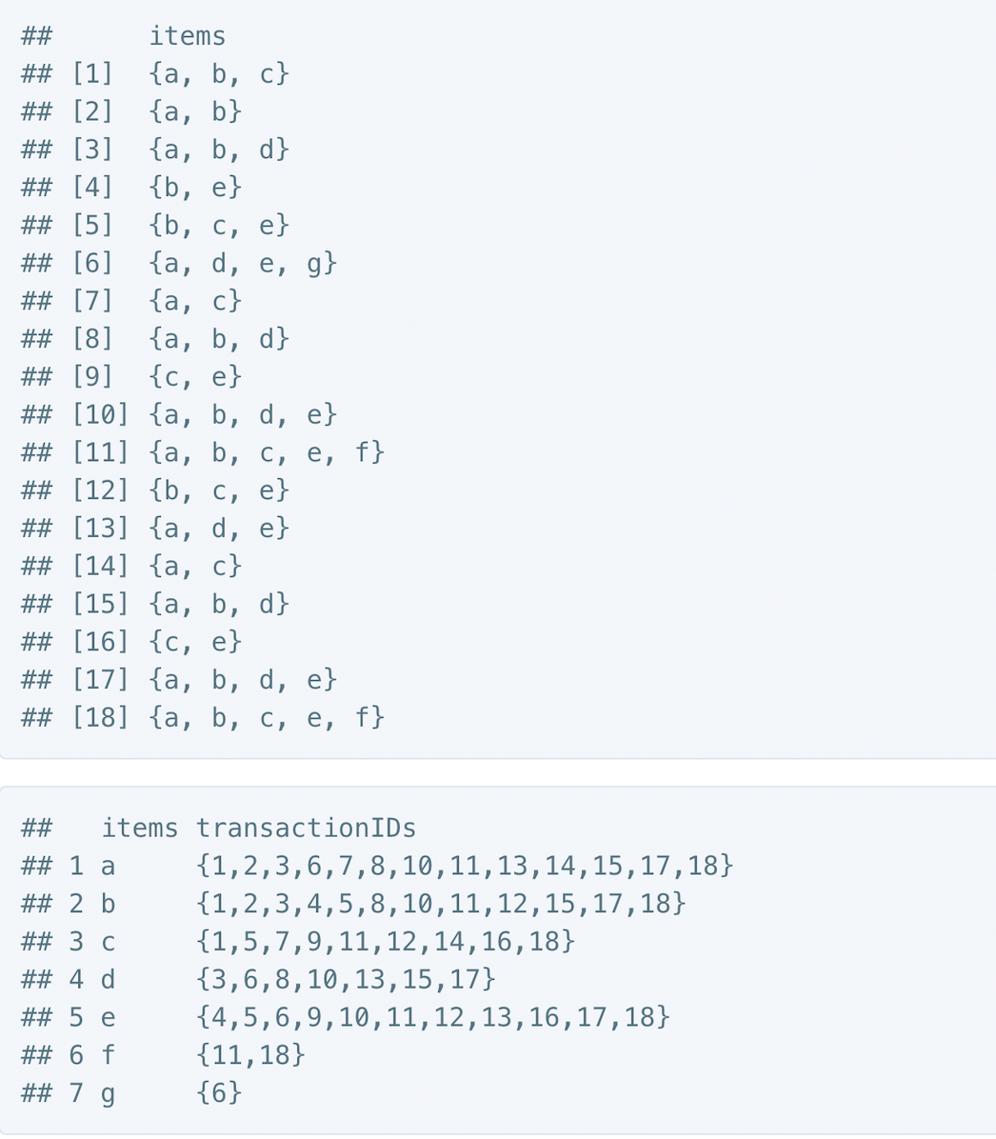
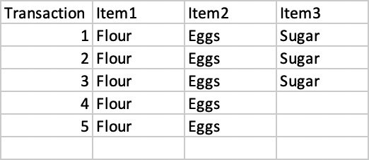
Overview of Association Rule
Fig 1: Association Rule
The above dataset can help us produce a set of rules. We can can assume the following association rules:
Rule 1: If Flour is purchased, then Egg is also purchased.
Rule 2: If Egg is purchased, then Flour is also purchased.
Rule 3: If Flour and Eggs are purchased, then Sugar is also purchased in 60% of the transactions.
Fig 2: Transaction data of items

Slide 5
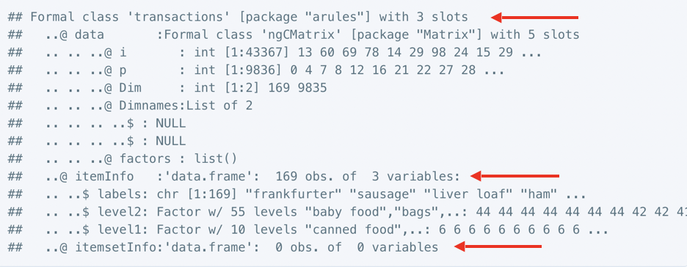
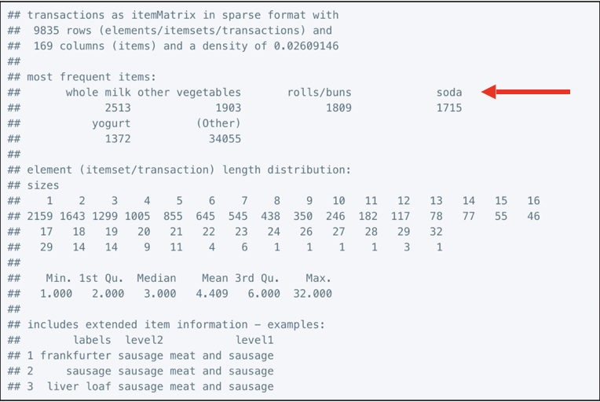
Data Analysis
Fig 3: Transactions is internally divided into 3 slots: data, itemInfo, and itemsetInfo
Fig 4: Displays the most frequently purchased items.
Whole Milk
Other vegetables
Rolls/buns
Soda
yogurt
Fig 3: Transaction dataset
Fig 4: Most frequent items

Slide 6
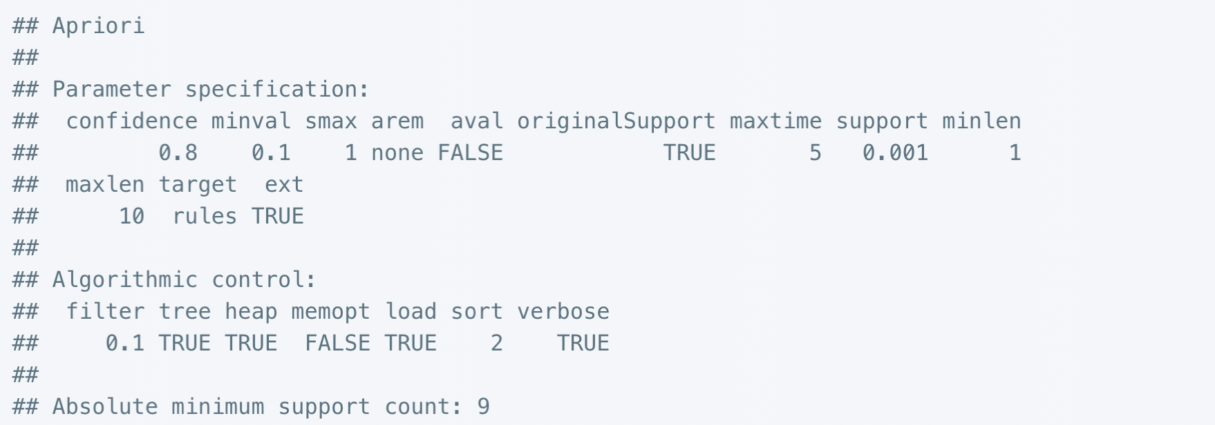
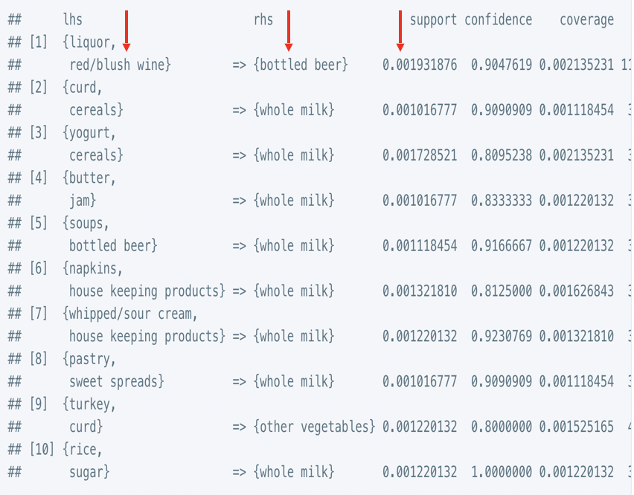
Applying the Algorithm
Fig 5, show us the outcome of running the Apriori algorithm
Fig 6, displays the list of rules with support, confidence, and lift value.
Fig 5: Parameter specification
Fig 6: List of rules

Slide 7
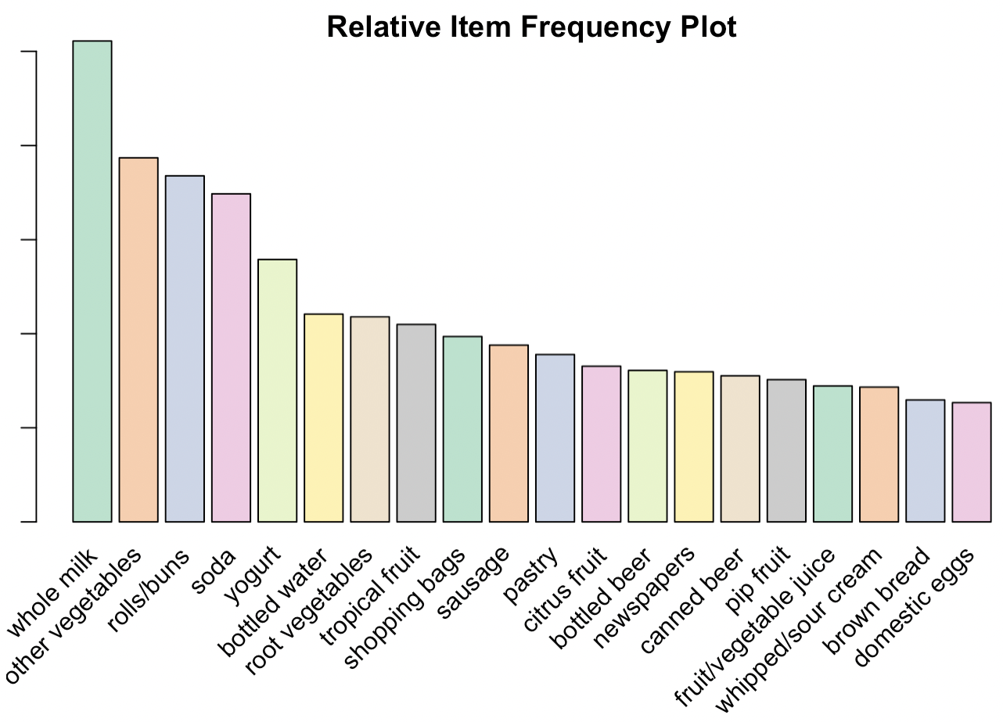
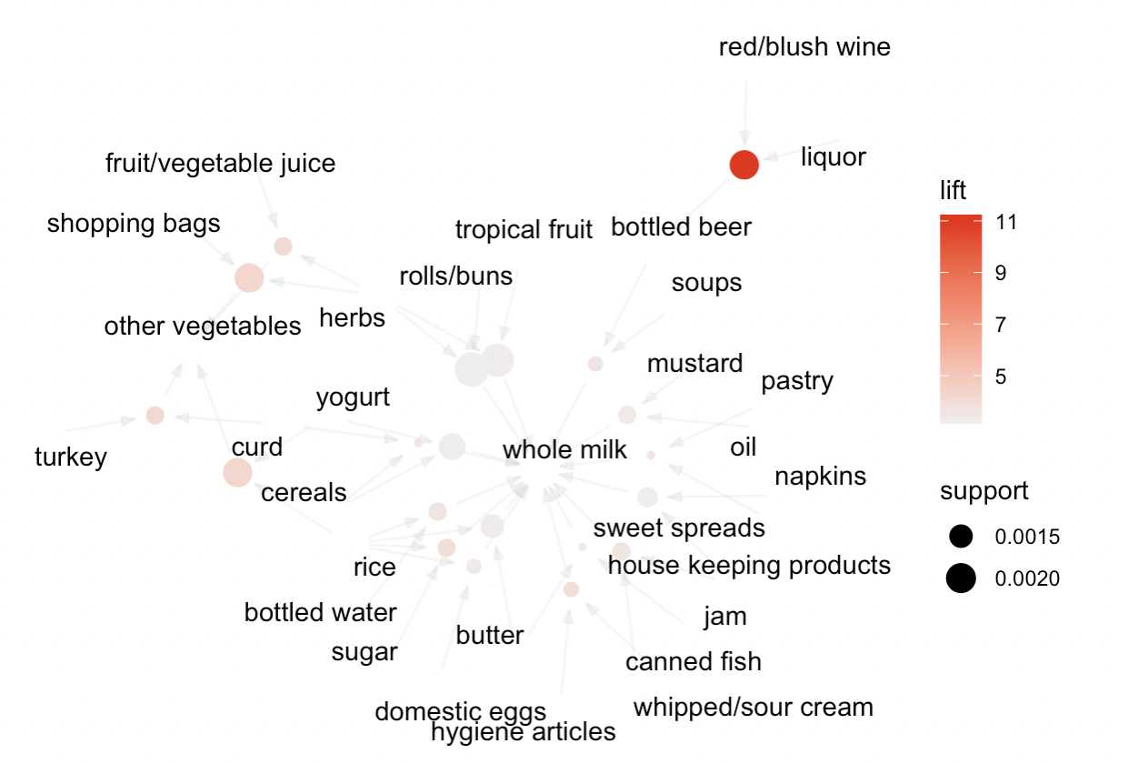
Visualizing Results
Fig 7, show Whole Milk was bought frequently compared to other items, followed by other vegetables.
Fig 8, depicts the correlation between one node to another
Fig 7: Relative Item Frequency Plot
Fig 8: Graph Based Visualization

Slide 8
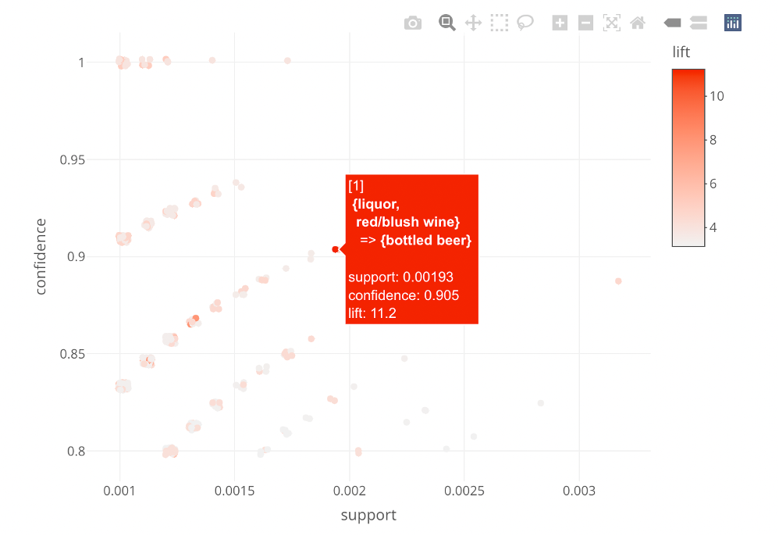
Interactive scattered plot
Support: It is the indication of how frequently the item appears in the data.
Confidence: It is the indication of number of times the set of rules are found true.
Example:
Support is the percentage of transaction in T that contains both Flour and Eggs
Confidence is the percentage of transaction in T, containing Flour, that also contain Eggs
Lift: The ratio of the confidence of the rule and the expected confidence of the rule.
Let's view the interactive plot

Slide 9
Findings and Explanation
Lift Support Confidence
{Liquor, Red/Blush Wine} ➔Bottled Beer
Other vegetables, Whole milk, Oil, Yogurt, Rice ➔ Root Vegetable
Citrus Fruit, Grape, Fruit/Vegetable juice ➔Tropical fruits
Pastry, Curd, Cereals, Sweet Spreads ➔Whole milk
11.2 0.001 90%
7.95 0.001 86%
8.06 0.001 84%
3.65 0.001 90%
Aisles Proposed:
Liquor Aisle – Liquor, Red/Blush Wine, Bottled Beer
Groceries Aisle – Other vegetables, Whole milk, Oil, Yogurt, Rice, Root Vegetable
Fruit Aisle – Citrus Fruit, Grape, Fruit/Vegetable juice, Tropical fruits
Breakfast Aisle – Pastry, Curd, Cereals, Sweet Spreads

Slide 10

Conclusion
Today’s ambitious retailer want to know their customers needs and choices before hand.
After analyzing the data with the help of Apriori algorithm we can suggest a retailer with detailed and effective ways to make their business decision.

Slide 11
References
“Visualizing association rules” Springer Link, 07 May. 2016, Visualizing Rules
“R Markdown theme Gallery” Andrew, May. 2021, R Markdown
“Introduction to Association Rule Mining in R ”, 14 May. 2021, Mining in R with Association rule
“Study on Apriori Algorithm and its Application in Grocery Store, 14 July. 2013, Study on Apriori
“Grocery Shopping Impulse Purchases with Apriori Algorithm and Association Rules in R” RALGO, 8 Oct. 2018, Grocery Shopping with Apriori
“Apriori Algorithm Explained” YouTube, 19 June. 2019, Apriori Algorithm Explained
“Product Recommendation Case Study Using Apriori Algorithm for a Grocery Store” Medium, 15 Jan. 2015, Shopping with Apriori

